Slide 1
DIGITAL STREAMING SYSTEM
POC PRESENTATION
NOVERMBER 2022

Slide 2






ERIC RAMOS
Software Developer

Slide 3
OVERVIEW
System Introduction
System Features
Entity Relationship Diagram (ERD)
Unit tests result (FE & BE)
Project demo

Slide 4
SYSTEM INTRODUCTION
DIGITAL STREAMING SYSTEM
A software solution for a Digital Streaming System which allows administrators to manage the movie catalogue information about the movies, actors, movie reviews (like Netflix or Amazon Prime) and users management, While normal user can access movies, actors and able to give movie reviews, This application stores details of movies, actors, movie reviews and users in nosql database.
The application frontend has to be implemented using:
HTML
CSS
JavaScript
React
Typescript
Redux
Loopback
MongoDB
Sonarqube
Jest
React Testing Library.

Slide 5
SYSTEM FEATURES
ADMIN
NON-ADMIN USER
Login and authentication (password encryption)
Saving details of movies (viewing, updating and deleting)
Saving details of actors, viewing, (updating and deleting)
Searching for movies and displaying details
Search for actors and displaying movies for specific actor
View and approve movie reviews given by film critics.
New administrators to register, approve new users
Register & Login
Viewing details of movies
Viewing details of actors
Searching for movies and displaying their details.
Search for actors and displaying movies for specific actor
View and add reviews given by film critics.
New users to register.

Slide 6
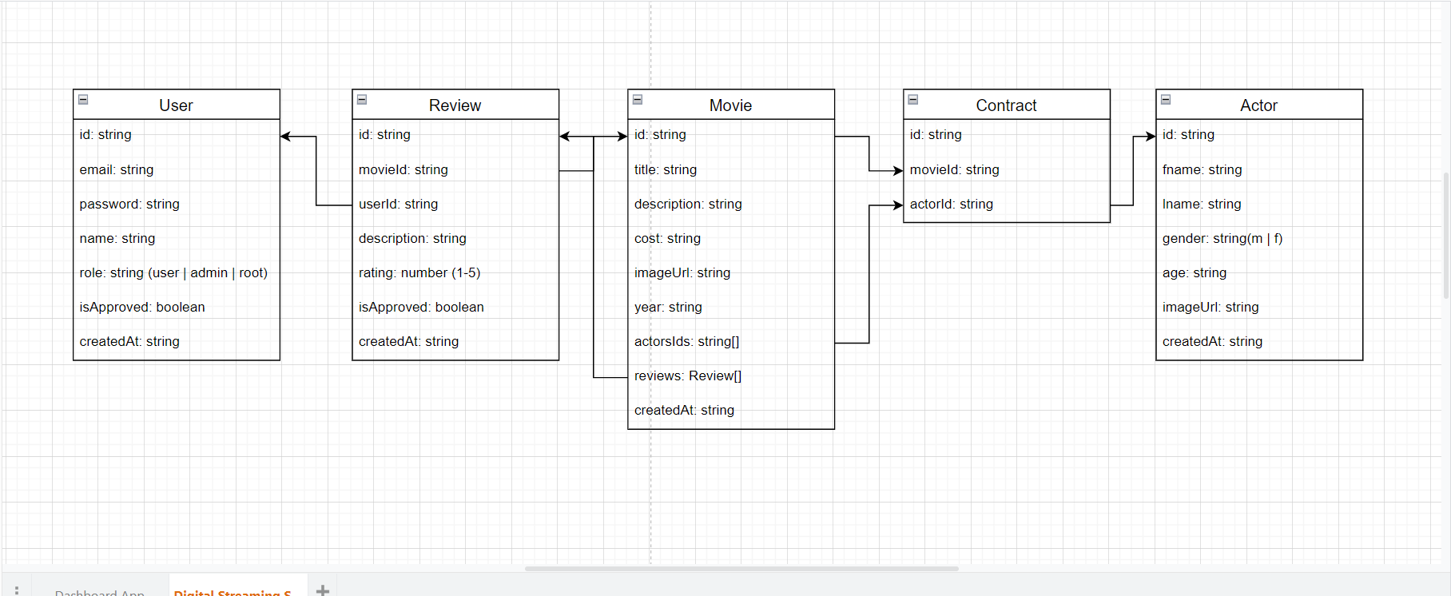
DESKTOP SOFTWARE

Slide 7
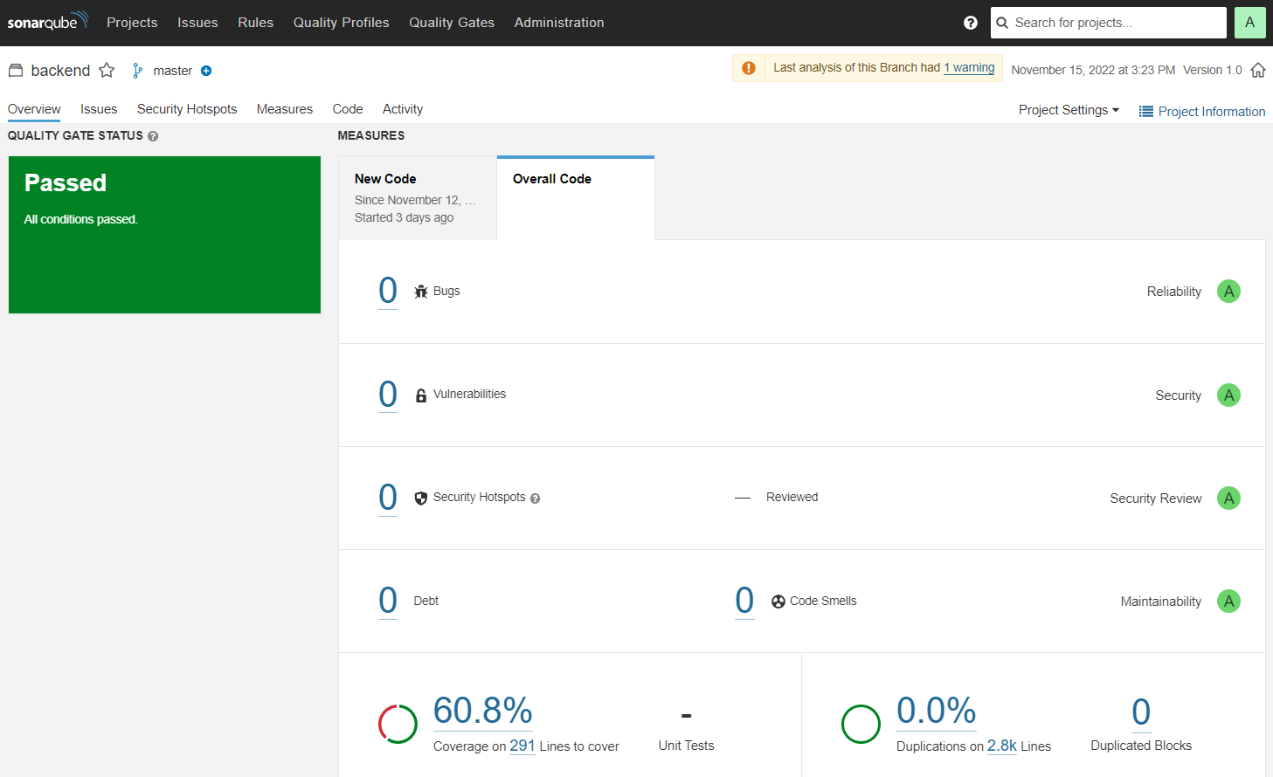
TEST RESULTS (Backend)

Slide 8

TEST RESULTS (Frontend)

Slide 9
PROJECT DEMO

